Slide 1
DeepPurple
Hackathon Data Challenge
Discussion
Vahid Tarokh
Applied Mathematics Group
School of Eng. & Applied Sciences (SEAS)
Harvard University

Slide 2
Our Prior Work
Proposed a online inference framework and fast algorithms to fit non-linear models to high dimensional non-stationary and non-linear time series
Proposed fast algorithm for multiple change point analysis of vector time series data
Proposed a novel methodology for optimal data prediction under unknown abrupt changes or smooth variations of data generating processes
Developed a methodology for change detection of non-stationary panel data

Slide 3
Multiple Change Point Analysis
Our new algorithm for analyzing the change points of time series data enables faster computation, and achieves more accuracy (compared with the classic approaches)
The idea is to turn the dependent data into independent ones using multiple windows, and combine the obtained information from each window
Our theorems guarantee provable optimal selection of change points
The proof of optimality was based on our newly derived technical tools
Applications to the study of eastern US temporal variability and El Nino data lead to some interesting discoveries

Slide 4
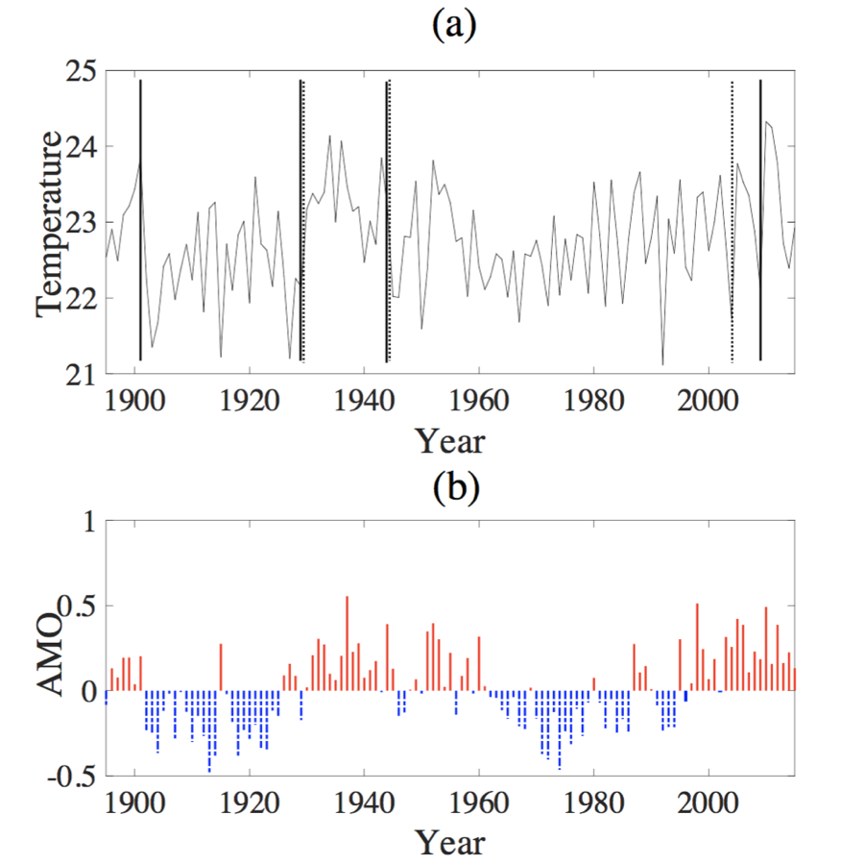
Multiple Change Point Analysis
An application: study the temporal variability over the eastern US
The segmentation of the time series of the eastern US temperature in Fig. (a) matches the phase shift of Atlantic Multi-decadal Oscillation (AMO) in Fig. (b)
The trends of the top curve and the bottom curve in each detected interval look the same
Using a global climate model, Sutton and Hodson [1] have indicated that the AMO plays an important role in driving the summertime temperature in the eastern US
Our algorithms produce results that are consistent with their paper [1]
[1]
Sutton, R. T., and Hodson, D. L. (2005), “Atlantic Ocean forcing of North American and European summer climate,” Science, 309(5731), 115–118.

Slide 5
Sequential Inference Framework
Our sequential inference framework enables fast computation and accurate modeling of a wide range of vector time series
A multi-dimensional function basis is used to approximate any continuous function
Our algorithm consists of an adaptation engine (introduced based on the update of relevant parameters and continuous monitoring of prediction errors)
Our theoretical analysis guarantees the convergence of the algorithm under stationary data generating processes assumption

Slide 6
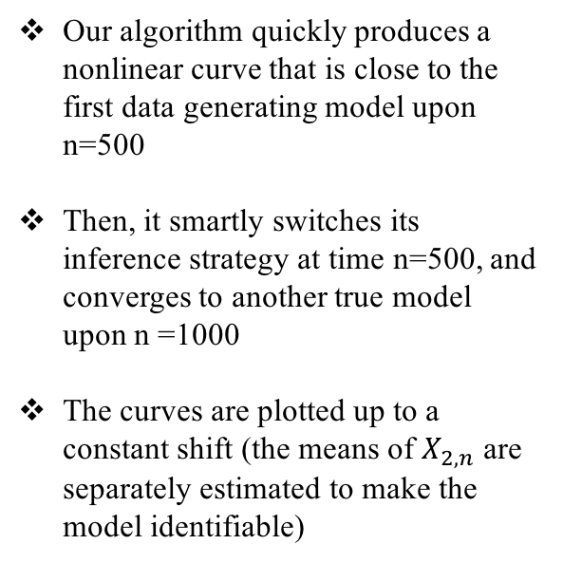
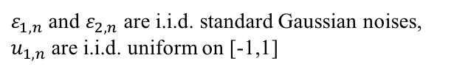
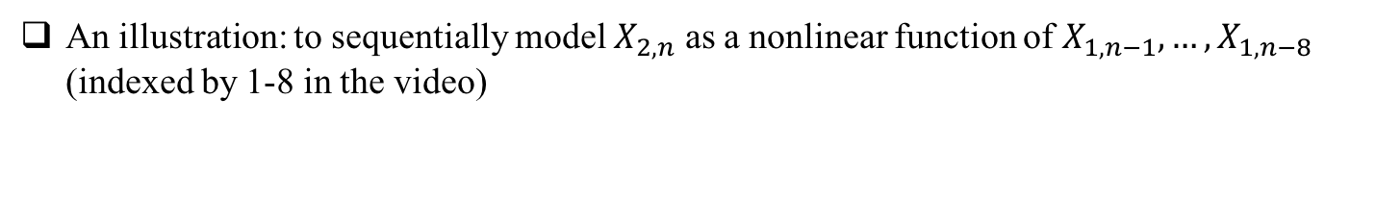
Sequential Inference Framework
An illustration: to sequentially model $X_{2,n}$ as a nonlinear function of $X_{1,n−1},…,X_{1,n−8}$ (indexed by 1-8 in the video)
True model:
$ε_{1,n}$ and $ε_{2,n}$ are i.i.d. standard Gaussian noises, $u_{1,n}$ are i.i.d. uniform on [-1,1]
Our algorithm quickly produces a nonlinear curve that is close to the first data generating model upon n=500
Then, it smartly switches its inference strategy at time n=500, and converges to another true model upon n =1000
The curves are plotted up to a constant shift (the means of $X_{2,n}$ are separately estimated to make the model identifiable)

Slide 7
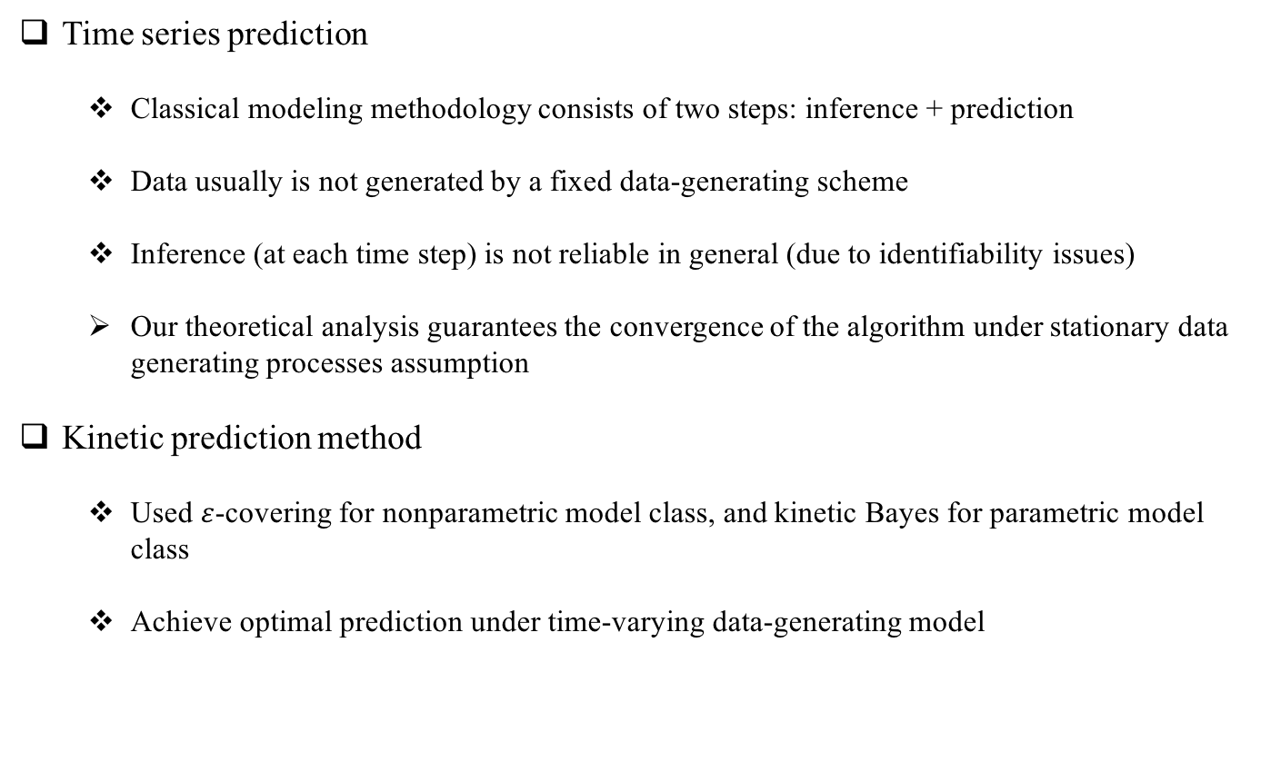
Optimal Prediction of Data
Time series prediction
Classical modeling methodology consists of two steps: inference + prediction
Data usually is not generated by a fixed data-generating scheme
Inference (at each time step) is not reliable in general (due to identifiability issues)
Our theoretical analysis guarantees the convergence of the algorithm under stationary data generating processes assumption
Kinetic prediction method
Used $ε$-covering for nonparametric model class, and kinetic Bayes for parametric model class
Achieve optimal prediction under time-varying data-generating model

Slide 8
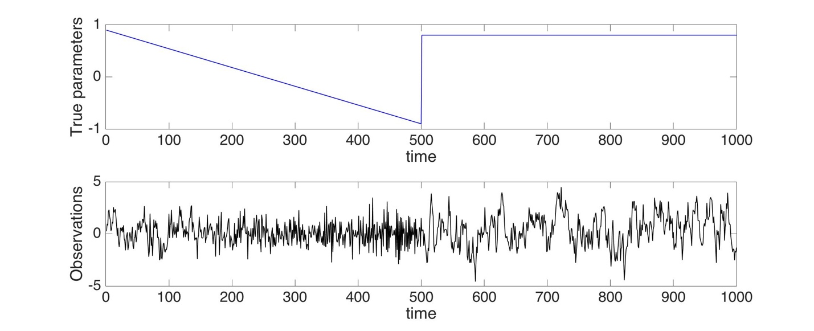
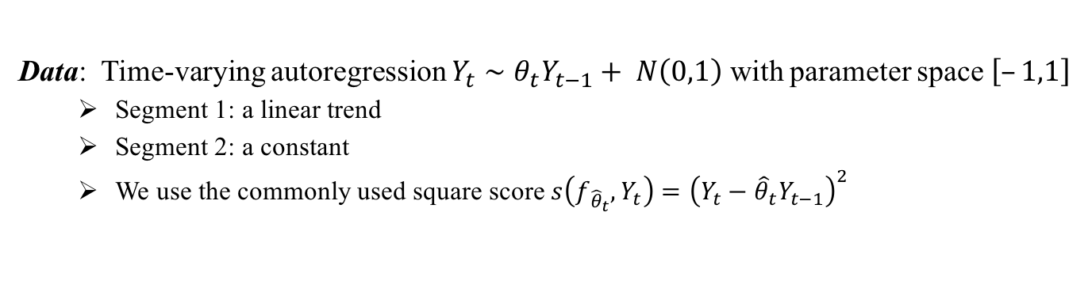
Synthetic Data Experiments – Dependent Data
Data: Time-varying autoregression $Y_{t}∼θ_{t}Y_{t−1}+ N\left(0,1\right)$ with parameter space$\left[–1,1\right]$
Segment 1: a linear trend
Segment 2: a constant
We use the commonly used square score $s\left(f_{{\hat{θ}}_{t}}, Y_{t}\right)={\left(Y_{t}−{\hat{θ}}_{t}Y_{t−1}\right)}^{2}$
(a)
(b)
Figure: (a) true parameters and (b) observations at each time step

Slide 9
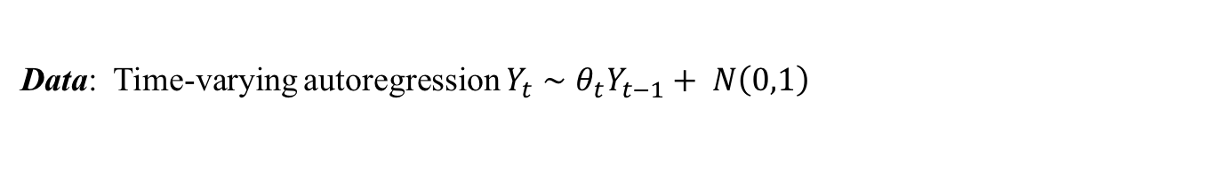
Synthetic Data Experiments – Dependent Data
Data: Time-varying autoregression $Y_{t}∼θ_{t}Y_{t−1}+ N\left(0,1\right)$

Slide 10
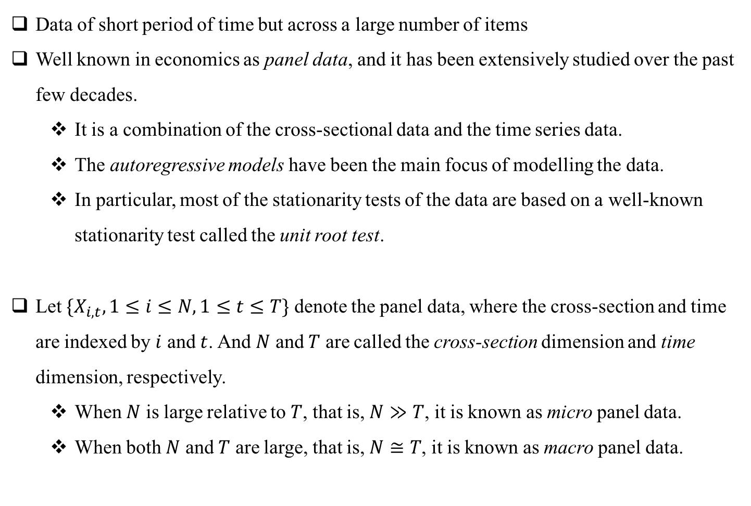
Change Detection for Panel Data
Data of short period of time but across a large number of items
Well known in economics as panel data, and it has been extensively studied over the past few decades.
It is a combination of the cross-sectional data and the time series data.
The autoregressive models have been the main focus of modelling the data.
In particular, most of the stationarity tests of the data are based on a well-known stationarity test called the unit root test.
Let $\{X_{i,t}, 1≤i≤N, 1≤t≤T\}$ denote the panel data, where the cross-section and time are indexed by $i$ and $t$. And $N$ and $T$ are called the cross-section dimension and time dimension, respectively.
When $N$ is large relative to $T$, that is, $N≫T$, it is known as micro panel data.
When both $N$ and $T$ are large, that is, $N≅T$, it is known as macro panel data.

Slide 11
Change Detection for Panel Data
Two-step approach:
first we apply the rank-based nonparametric test to each cross-section data,
then merge their p-values through two methods
Fisher’s method: obtain an overall test statistics.
Benjamini-Hochberg (BH) procedure: adjust the p-values to control the expected proportion of the false positives.
Here we show one realization of the cross-sections in both the first 50 and second 50 realizations.
First half model_1 and second half model_2
First half model_1 and second half model_2

Slide 12
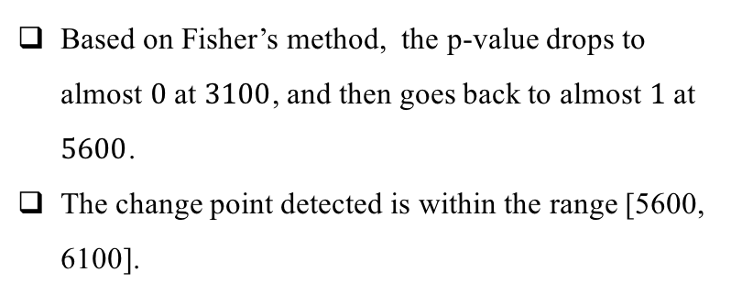
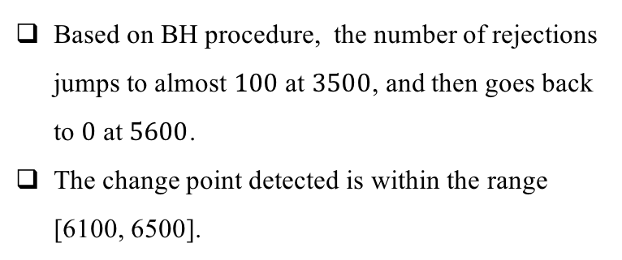
Change Detection for Panel Data
Based on Fisher’s method, the p-value drops to almost $0$ at $3100$, and then goes back to almost $1$ at $5600$.
The change point detected is within the range [5600, 6100].
Based on BH procedure, the number of rejections jumps to almost $100$ at $3500$, and then goes back to $0$ at $5600$.
The change point detected is within the range [6100, 6500].

Slide 13
DeepPurple Data Challenge
Two main techniques:
Estimate local spectral density (Short-window Fourier transform)
Dynamic time warping (DTW) algorithm: compute the distance between curves
Subject 2 among 21 subjects
Four physiological data: accelerometer (ACC), electro-dermal activity (EDA), heart rate (HR), skin temperature (Temp)
Use physiological data to infer infection

Slide 14
Backup Slides

Slide 15
Predicting Rare Events
We proposed a new class of models in order to explore and quantify causal relationships between stochastic processes when rare events (such as drastic changes and extreme values) happen
The model was inspired by the fact that extreme values are usually heavy tailed random variables. The models seek to predict rare events by modeling the functional causal relationship among extreme values of time series
We have developed an efficient and robust sequential Monte Carlo software to infer the parameters of the models from a Bayesian perspective

Slide 16
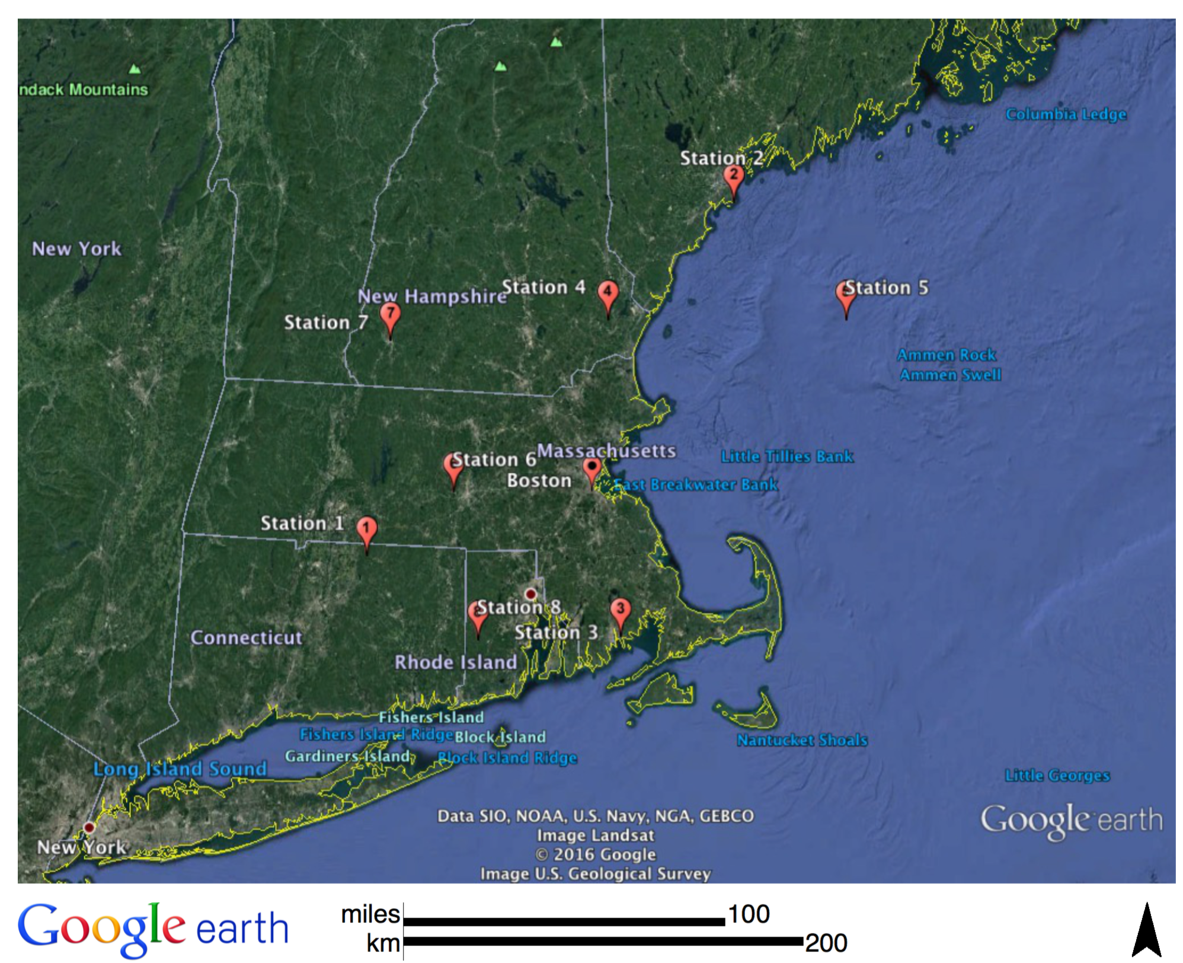

Predicting Rare Events
An application: to predict the days with extreme ozone density
The left plot shows the locations of 8 observation stations
They lead to different ROC curves mainly due to
the data variations in stations (since the ozone distributions highly depend on the local weather and vary a lot)
the variances of our Monte Carlo methods
It is possible to improve the predictions by fine tuning prior information for each station (currently we use the same model and prior)

Slide 17
Predicting Rare Events
We use the ozone and temperature data recorded at 8 observation stations around Boston during 2003-2012 summer time (May-Sept)
The left plot shows the receiver operating characteristic (ROC) curve for one-day ahead prediction of extreme ozone
The better curves deviate more from the diagonal line from the left top to the right bottom corners (which corresponds to a completely random guess)
Our algorithms produce nontrivial predictions of high ozone using only the past temperature data. Up to our knowledge, it is the first study of one-day ahead prediction on real ozone data

Slide 18
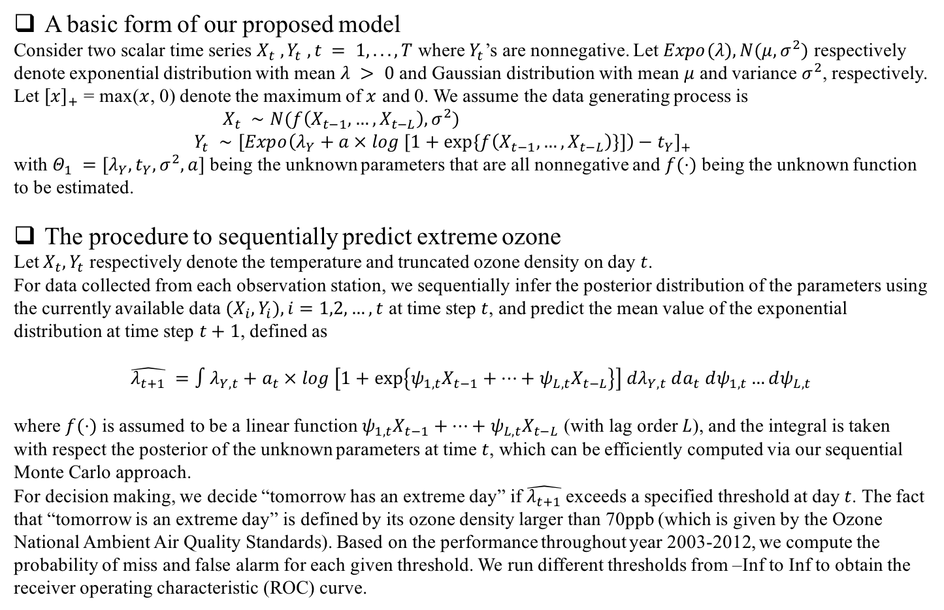
Predicting Rare Events (Backup slide)
A basic form of our proposed model
Consider two scalar time series $X_{t} , Y_{t} , t = 1, . . . , T$ where $Y_{t}$’s are nonnegative. Let $Expo(λ), N(μ, σ^{2})$ respectively denote exponential distribution with mean $λ > 0$ and Gaussian distribution with mean $μ$ and variance $σ^{2}$, respectively. Let ${\left[x\right]}_{+}$ = max($x$, 0) denote the maximum of $x$ and 0. We assume the data generating process is
$X_{t} ∼N(f\left(X_{t−1},…,X_{t−L}\right),σ^{2})$
$Y_{t} ∼{\left[Expo\left(λ_{Y}+a × log [1+\exp\left\{f\left(X_{t−1},…,X_{t−L}\right)\right\}]\right)−t_{Y}\right]}_{+}$
with $Θ_{1} =[λ_{Y},t_{Y},σ^{2},a]$ being the unknown parameters that are all nonnegative and $f(⋅)$ being the unknown function to be estimated.
The procedure to sequentially predict extreme ozone
Let $X_{t}, Y_{t}$ respectively denote the temperature and truncated ozone density on day $t$.
For data collected from each observation station, we sequentially infer the posterior distribution of the parameters using the currently available data $(X_{i}, Y_{i}), i=1,2,…,t$ at time step $t$, and predict the mean value of the exponential distribution at time step $t+1$, defined as
$$\hat{λ_{t+1}} =∫λ_{Y,t}+a_{t} × log \left[1+\exp\left\{ψ_{1,t}X_{t−1}+…+ψ_{L,t}X_{t−L}\right\}\right] dλ_{Y,t} da_{t} dψ_{1,t}…dψ_{L,t}$$
where $f(⋅)$is assumed to be a linear function $ψ_{1,t}X_{t−1}+…+ψ_{L,t}X_{t−L}$ (with lag order $L$), and the integral is taken with respect the posterior of the unknown parameters at time $t$, which can be efficiently computed via our sequential Monte Carlo approach.
For decision making, we decide “tomorrow has an extreme day” if $\hat{λ_{t+1}}$exceeds a specified threshold at day $t$. The fact that “tomorrow is an extreme day” is defined by its ozone density larger than 70ppb (which is given by the Ozone National Ambient Air Quality Standards). Based on the performance throughout year 2003-2012, we compute the probability of miss and false alarm for each given threshold. We run different thresholds from –Inf to Inf to obtain the receiver operating characteristic (ROC) curve.

Slide 19
Sequential Inference Framework (Backup slide)
To achieve reliable performance in terms of prediction and nonlinearity identification, the implementations of our algorithm are based on three key elements: the adaptive step size, the online update, and the automatic tuning of algorithm parameters
The adaptive step size
This module enables the algorithm to either converges to a stationary model if the true data-generating model is fixed, or track varying data-generating models (as was illustrated by the video)
The online update
This module enables the algorithm to use sufficient statistics to sequentially update a complex nonlinear model with only linear computational cost. The basic idea is to decompose the original optimization problem into two parts that are easier to solve and iterate between them. One part involves linear updates, and the other enables a closed-form solution.
Automatic tuning of control parameters
This module continuously monitors the one-step ahead prediction errors upon each newly arrived data point, and in turn wisely tune the algorithm parameters. This part helps to stabilize the performance of our algorithm when the underlying date generating model varies over time. It can be regarded as a substitute to the usual “cross-validation” method, which is not applicable to a real-world time series data that is not permutable and “once in a lifetime”.

Slide 20
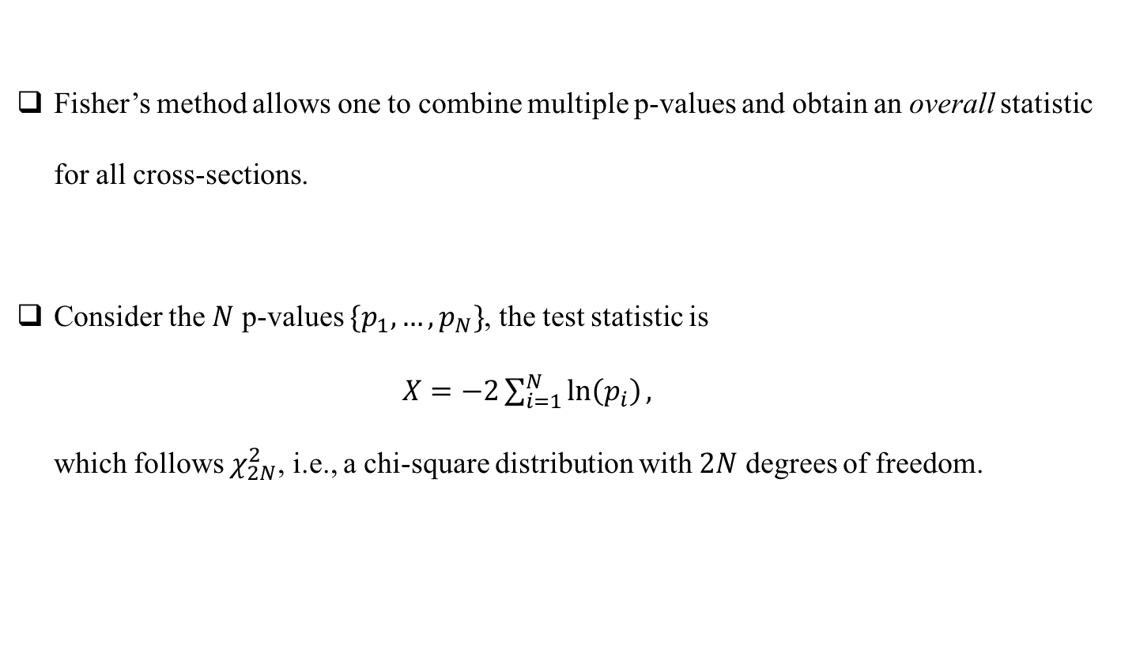
Combine p-values: Fisher’s method
Fisher’s method allows one to combine multiple p-values and obtain an overall statistic for all cross-sections.
Consider the $N$ p-values $\{p_{1}, …,p_{N}\}$, the test statistic is
$X=−2\sum_{i=1}^{N}{\ln\left(p_{i}\right)},$
which follows $χ_{2N}^{2}$, i.e., a chi-square distribution with $2N$ degrees of freedom.

Slide 21
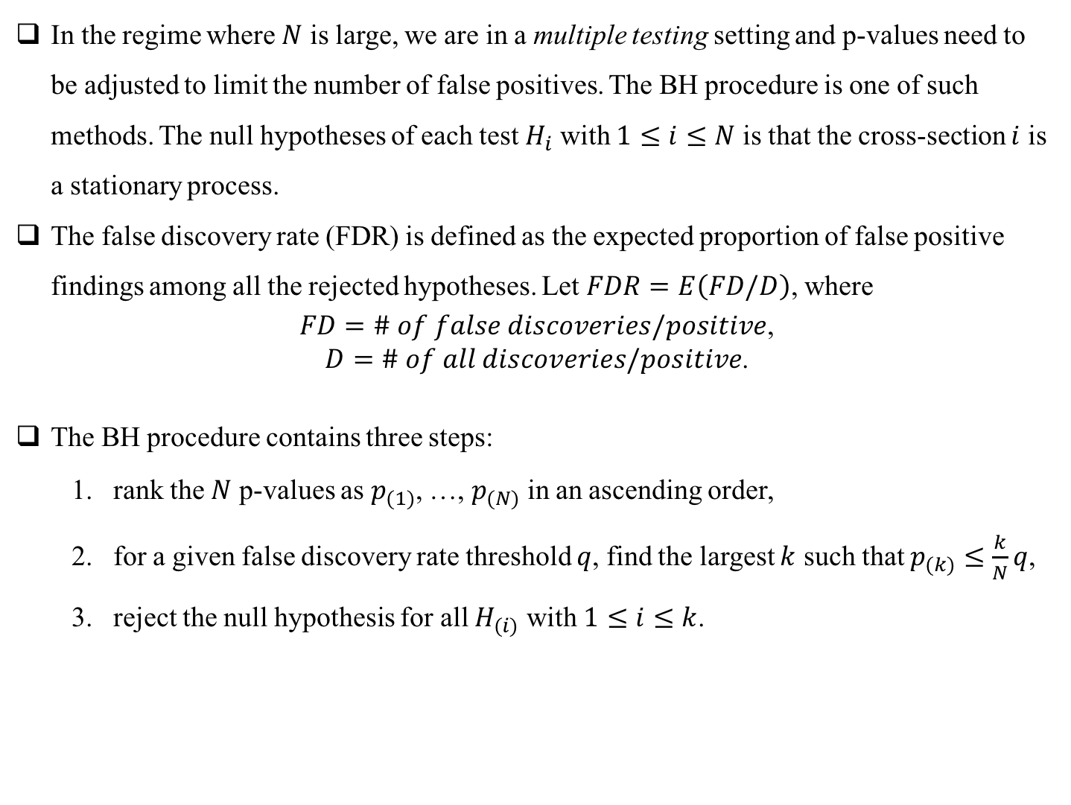
Combine p-values: Benjamini-Hochberg (BH) procedure
In the regime where $N$ is large, we are in a multiple testing setting and p-values need to be adjusted to limit the number of false positives. The BH procedure is one of such methods. The null hypotheses of each test $H_{i}$ with $1≤i≤N$ is that the cross-section $i$ is a stationary process.
The false discovery rate (FDR) is defined as the expected proportion of false positive findings among all the rejected hypotheses. Let $FDR=E\left(FD/D\right)$, where
$FD=\# of false discoveries/positive$,
$D=\# of all discoveries/positive$.
The BH procedure contains three steps:
rank the $N$ p-values as $p_{(1)}$, …, $p_{(N)}$ in an ascending order,
for a given false discovery rate threshold $q$, find the largest $k$ such that $p_{(k)}≤\frac{k}{N}q$,
reject the null hypothesis for all $H_{(i)}$ with $1≤i≤k$.

Slide 22
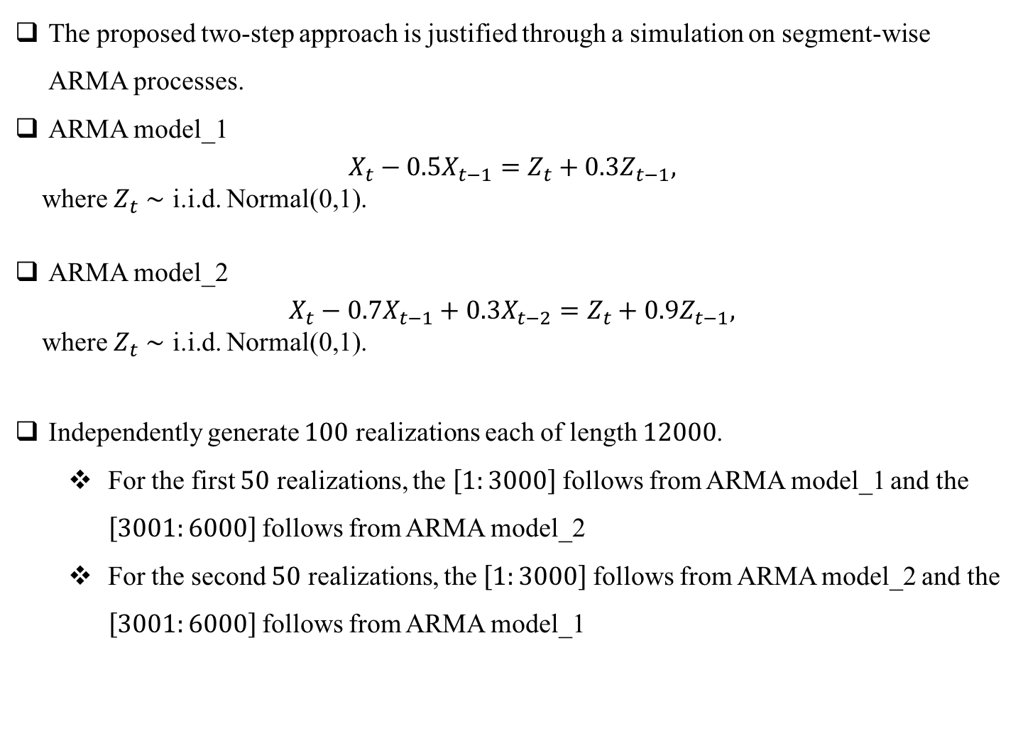
Segment-wise Stationary Processes
The proposed two-step approach is justified through a simulation on segment-wise ARMA processes.
ARMA model_1
$$X_{t}−0.5X_{t−1}=Z_{t}+0.3Z_{t−1},$$
where $Z_{t}∼$ i.i.d. Normal(0,1).
ARMA model_2
$$X_{t}−0.7X_{t−1}+0.3X_{t−2}=Z_{t}+0.9Z_{t−1},$$
where $Z_{t}∼$ i.i.d. Normal(0,1).
Independently generate $100$ realizations each of length $12000$.
For the first $50$ realizations, the $\left[1:3000\right]$follows from ARMA model_1 and the $\left[3001:6000\right]$follows from ARMA model_2
For the second $50$ realizations, the $\left[1:3000\right]$follows from ARMA model_2 and the $\left[3001:6000\right]$follows from ARMA model_1

Slide 23
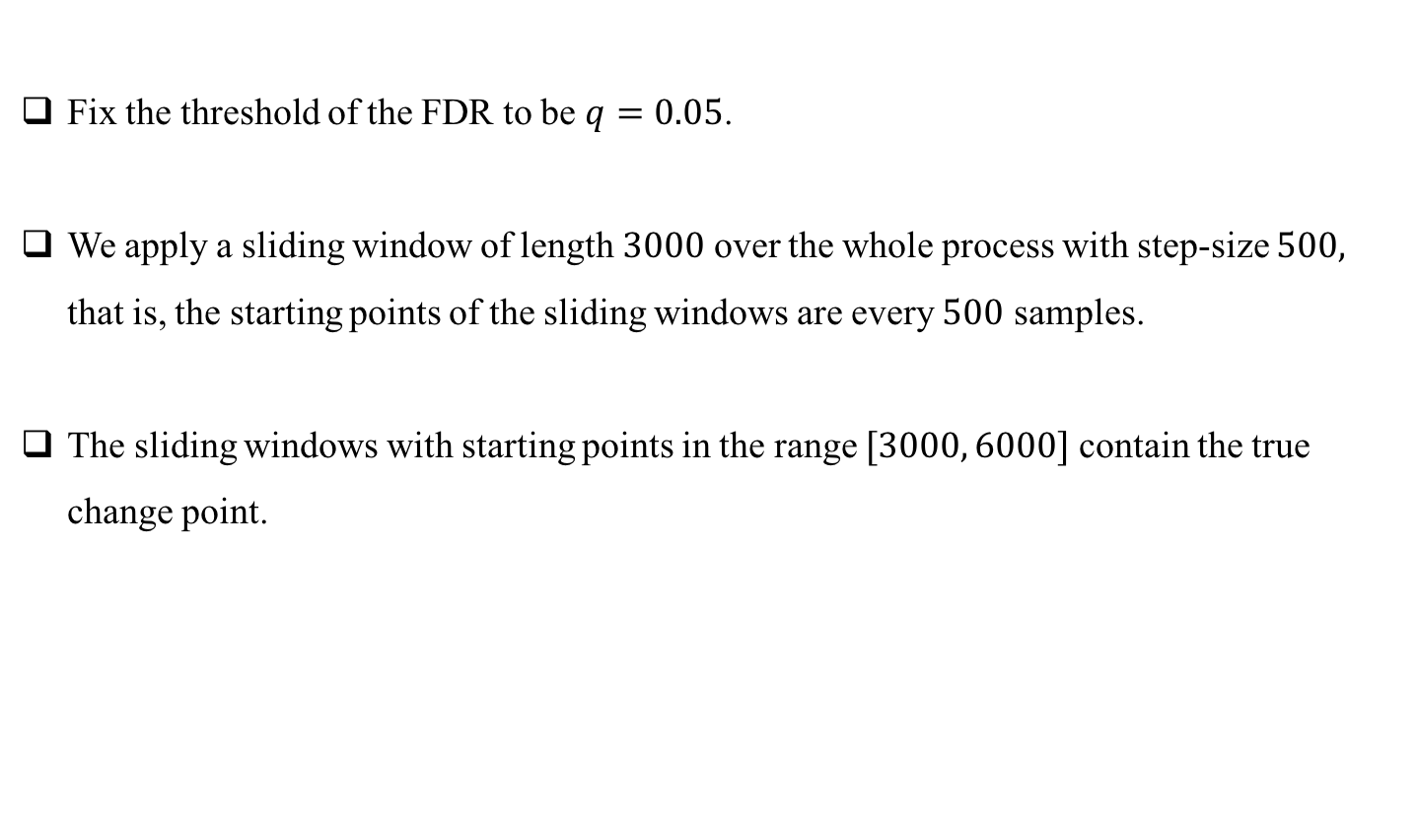
Segment-wise Stationary Processes
Fix the threshold of the FDR to be $q=0.05$.
We apply a sliding window of length $3000$ over the whole process with step-size $500,$ that is, the starting points of the sliding windows are every $500$ samples.
The sliding windows with starting points in the range $[3000, 6000]$ contain the true change point.

